Slide 1
Introduction to Machine Learning

Slide 2
What is machine learning?
Machine learning is a subset of artificial intelligence (AI) where machines learn from data instead of being programmed with fixed rules.
In ML, we give:
Data
Algorithms
The system finds patterns and makes decisions or predictions on its own.
Simple Example
Email spam filter
Student result prediction
Movie recommendation on Netflix
The more data it gets, the better it learns.

Slide 3
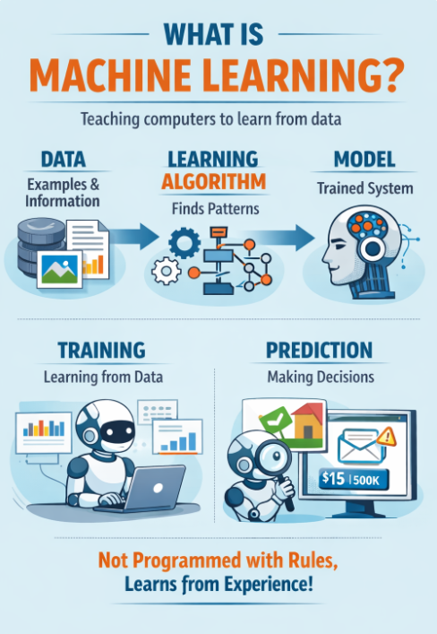

Slide 4
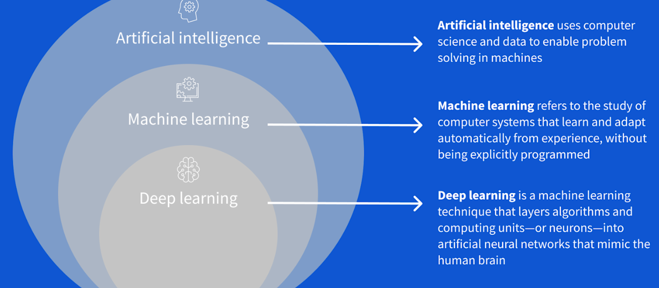
Relationship Between AI, ML, and DL

Slide 5
Artificial Intelligence -
AI means creating machines that can:
Think like humans
Make decisions
Solve problems
Understand language
Examples of AI
Chatbots
Face recognition
Self-driving cars
Voice assistants (Alexa, Siri)
AI does NOT always learn from data. Some AI systems work using rules written by humans.

Slide 6
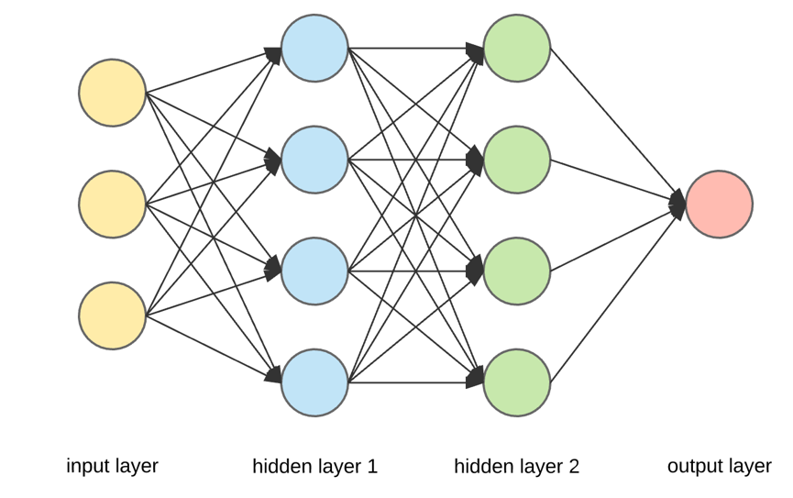
Deep Learning (DL) -
Deep Learning is a subset of Machine Learning. It utilises multiple layers of neural networks to automatically learn patterns from vast amounts of data and make predictions.
DL works best with:
Large data
Images
Audio
Videos
Examples of DL
Face recognition
Speech recognition
Medical image analysis
Self-driving cars
The input layer takes basic information (numbers or features).
This information moves to hidden layer 1, where neurons combine inputs and find simple patterns.
In hidden layer 2, these patterns are refined into more meaningful ones.
Each connection has a weight that controls how important the information is.
The output layer gives the final result or prediction.

Slide 7
Difference Between AI, ML, and DL
Feature | Artificial Intelligence (AI) | Machine Learning (ML) | Deep Learning (DL)
Meaning | Making machines intelligent | Machines learn from data | Learning using neural networks
Scope | Very broad | Subset of AI | Subset of ML
Data dependency | Not always | Yes | Very high
Human rules | Can use rules | Less rule-based | No manual rules
Complexity | Medium | High | Very High
Examples | Chatbot, Game AI | Spam filter, Prediction | Face & speech recognition

Slide 8
Machine Learning: Basic Terminology
Data -
Data is the raw information given to the machine.
Examples:
Student marks
House prices
Images
Emails
Sensor readings
Note: No data → No Machine Learning

Slide 9
Dataset
A dataset is a collection of data.
Example (House Price Dataset):
Features (Independent Variables)
Features are the input columns used to make predictions.
Example:
Area
Number of bedrooms
Location
In the above table:
Area and Bedrooms = Features (If the objective is to predict the house price)
Area (sq ft) | Bedrooms | Price (₹)
1000 | 2 | 40L
1500 | 3 | 65L

Slide 10
Label / Target (Dependent Variable) -
The output we want to predict.
Example:
House price
Pass / Fail
Spam / Not Spam
In the table:
Price = Label
Training Data -
The data used to teach the model.
The model learns patterns from training data.
Example:
80% of total data is usually used for training.

Slide 11
Testing Data -
The data used to check how well the model learned.
Model never sees this data during training.
Example:
Remaining 20% data is used for testing.
Algorithm -
An algorithm is the learning procedure / method. In simple words - Algorithm tells the machine HOW to learn from data.
Example:
Linear Regression algorithm
K-Means algorithm
Backpropagation (in neural networks)
Algorithm tells how learning happens.

Slide 12
Model –
A model is the result after learning.
In simple words - Model is the trained brain created after applying the algorithm on data.
Algorithm + Training Data = Trained Model
Examples:
Trained Linear Regression equation
Trained Decision Tree
Algorithm (For Linear regression):
Formula to learn best line:
y = mx + c
Model:
After training:
y = 2.5x + 10

Slide 13
Training -
Training means:
Feeding data to the algorithm so the model can learn patterns.
Example:
Learning how area affects house price
Learning which words indicate spam email
Prediction -
Using the trained model to predict output for new data.
Example:
New house → ₹72 Lakhs
New email → Spam

Slide 14
Accuracy -
Accuracy tells how correct the model is.
Example:
If 90 out of 100 predictions are correct Accuracy = 90%
Overfitting -
Model learns too well on training data but performs poorly on new data.
Example:
Student memorizes answers instead of understanding.
Bad for real-world use

Slide 15
Underfitting -
Model is too simple and fails to learn patterns.
Example:
Student doesn’t study enough.
Poor performance
Bias & Variance –
When we train a Machine Learning model, errors happen. These errors mainly come from two reasons:
Model is too simple → Bias
Model is too complex → Variance

Slide 16
What is Bias?
Bias = Error due to wrong assumptions
In simple words:
Model is too simple, so it cannot learn patterns properly.
Student Example:
Student studies only 1 page for whole syllabus
Result → Poor marks
ML Example:
Using a straight line to fit curved data
Result:
Poor training accuracy
Poor testing accuracy
This is called Underfitting

Slide 17
What is Variance?
Variance = Error due to over-learning
In simple words:
Model learns too much, even noise, so it fails on new data.
Student Example:
Student memorizes answers word-to-word
New question → Confused
ML Example:
Very complex model fits every data point exactly
Result:
Very high training accuracy
Very low testing accuracy
This is called Overfitting
Bias–Variance Tradeoff
If bias decreases, variance increases If variance decreases, bias increases
Goal of ML = Balance both

Slide 18
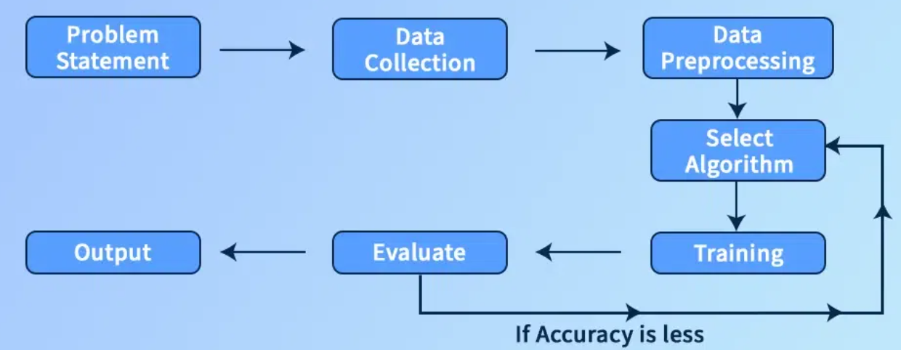
Working Of Machine Learning Model

Slide 19
Problem Statement -
This is the first step of any ML project. Here we clearly define what problem we want to solve.
Examples:
Predict house price
Classify email as spam or not spam
Predict student performance
Without a clear problem, ML cannot start.
Data Collection -
In this step, we collect data related to the problem.
Sources of data:
Databases
CSV files
Sensors
Websites
Surveys
Quality and quantity of data directly affect model performance.

Slide 20
Data Preprocessing
Raw data is usually dirty and incomplete, so it must be cleaned.
Includes:
Handling missing values
Removing noise and duplicates
Converting categorical data to numerical
Feature scaling / normalization
“Garbage in → Garbage out” So preprocessing is very important.
Select Algorithm
Here we choose how the machine will learn.
Depends on:
Type of problem (classification / regression / clustering)
Size of data
Complexity
Examples:
Linear Regression
Decision Tree
KNN
Neural Network
Algorithm decides the learning strategy, not the final output.

Slide 21
Training
In this step, the selected algorithm is applied to training data.
Model learns patterns
Model parameters are adjusted
Learning happens here
Output of training = Trained Model
Evaluation
The trained model is tested using unseen (testing) data.
Evaluation metrics:
Accuracy
Precision
Recall
Error
This step checks how good the model is.

Slide 22
If Accuracy Is Less (Feedback Loop)
If performance is not satisfactory:
Change algorithm
Tune parameters
Improve data preprocessing
Add more data
Then retrain the model again.
This loop continues until acceptable accuracy is achieved.
Output (Prediction)
Once the model performs well, it is used for final predictions.
Examples:
Predicted house price
Spam / Not spam
Pass / Fail
This is the final usable result of Machine Learning.

Slide 23
Types of Machine Learning
Machine Learning is mainly classified into three types based on availability of labeled data:
Supervised Learning
Unsupervised Learning
Semi-Supervised Learning
1 - Supervised Learning –
Supervised Learning is a type of ML where the model is trained using labeled data.
Labeled data means input + correct output is already known.

Slide 24
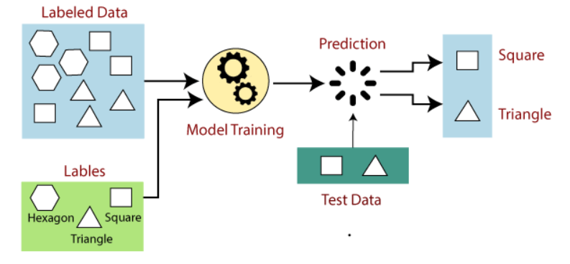
How it Works
Data contains features and labels
Model learns the relationship between them
Used to predict output for new data
Example –
Input | Output
Student marks | Pass / Fail
House area | Price
Email text | Spam / Not Spam

Slide 25
Types of Supervised Learning
Classification – Output is a category
Spam / Not Spam
Disease / No Disease
Regression – Output is a numerical value
House price
Salary prediction
Common Algorithms
Linear Regression
Logistic Regression
Decision Tree
KNN
SVM

Slide 26
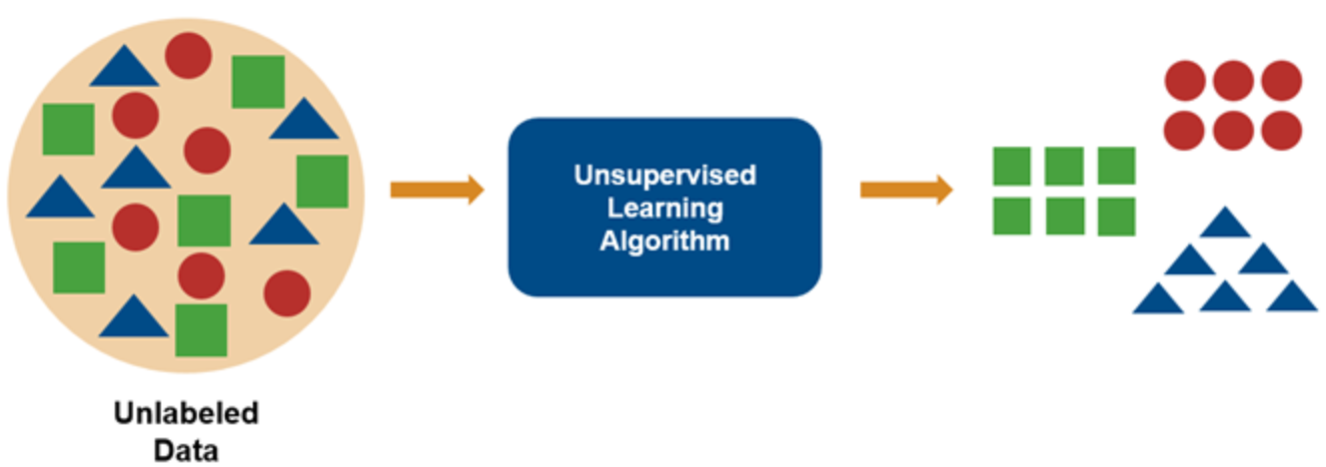
2 - Unsupervised Learning –
Unsupervised Learning is a type of ML where the data has no labels.
Model learns patterns by itself.
How it Works
Only input data is given
Model finds hidden structure
No correct output is provided

Slide 27
Examples -
1 - Customer segmentation – Segmenting the customers based on like - Purchase frequency (High spending customers, Budget customers, Occasional buyers), or Age (younger, middle gae and older etc.).
Real-Life Use - Personalized marketing, Discounts for specific groups
2 - Grouping Similar Products - Products are grouped based on similar features (Price, Category, Rating etc).
Real-Life Use - Recommendation systems, Inventory management

Slide 28
Main Tasks
Clustering – Grouping similar data
Association – find hidden relationships between items in a dataset.
It answers: Which items are frequently bought together?
Example: butter with bread.
Common Algorithms
K-Means
Hierarchical Clustering
Apriori

Slide 29
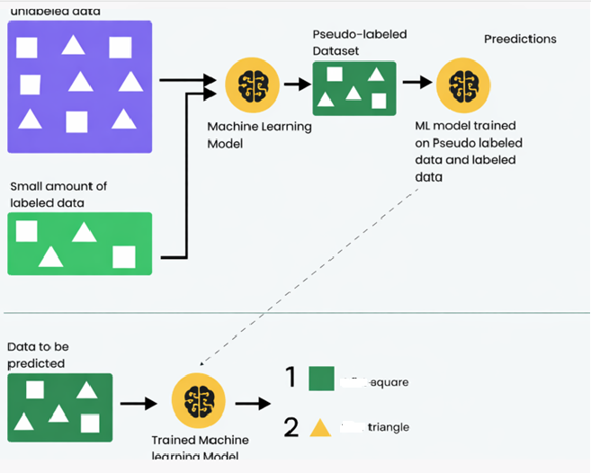
Semi-Supervised Learning

Slide 30
Semi-Supervised Learning uses small labeled data + large unlabeled data.
Combination of supervised and unsupervised learning.
Why Needed?
Labeling data is expensive and time-consuming
Large unlabeled data is easily available
How it Works
Model learns from labeled data
Improves learning using unlabeled data

Slide 31
Examples
Face recognition - Recognize whose face it is from an image.
Few images are labeled (Example: “This is Vedant”, “This is Aman”)
Thousands of images are unlabeled -we don’t know which one is which. These images may belong to Vedant, Aman, or even new people, but no name is attached.
From labeled images, model learns:
Vedant’s face features
Aman’s face features
If an unlabeled image looks very similar to Vedant’s labeled faces, the model assumes it belongs to Vedant.
This process is called pseudo-labeling
What if unlabeled images contain new people?
That is also possible.
Model may:
Ignore them
Or create a separate group
Or need later human labeling
Real-Life Applications
Mobile face unlock
Attendance systems
CCTV surveillance
Simple Example -
Teacher gives 5 solved examples (labeled)
Student practices 100 unsolved questions (unlabeled)
Student learns patterns, even without answers
Notes:
Key Points
Few labels, many unlabeled samples
Better accuracy than unsupervised
Cheaper than fully supervised

Slide 32
Speech Recognition – Convert spoken voice into text.
Few audio files have correct transcripts
Large amount of audio data has no text
How Semi-Supervised Learning Works
Model learns speech patterns from labeled audio
Improves pronunciation and accent understanding using unlabeled audio
Produces better text output
Real-Life Applications
Google Assistant
Alexa
Voice typing

Slide 33
Medical Image Analysis - Detect diseases from X-ray, MRI, CT scans.
Data Situation
Few images are labeled by doctors
Huge number of medical images are unlabeled
How Semi-Supervised Learning Works
Model learns disease features from labeled scans
Uses unlabeled scans to improve accuracy
Helps in early and fast diagnosis
Why Semi-Supervised?
Doctor labeling is costly and slow
Medical images have similar patterns
Real-Life Applications
Cancer detection
Tumor identification
Disease diagnosis support

Slide 34
Comparison Table
Aspect | Supervised | Unsupervised | Semi-Supervised
Labeled data | Yes | No | Partial
Human guidance | High | None | Limited
Accuracy | High | Medium | High
Cost | High | Low | Medium
Example | Spam detection | Customer groups | Face recognition

